Slide 1


Slide 2


Dataman Solution’s for Paper Industry - “PAPER BIZ WEB”
BEING SUCCESSFULLY USED BY OVER 75 MILLERS IN 12 STATES
A Comprehensive ERP Solution for Pulp & Paper Mills, Kraft Paper, Writing Printing, Multilayer Duplex, Tissue Paper & News Print.
Dataman’s “PAPER BIZ WEB” Software Fulfils all your Business needs.
PBW Provides you with the Extensive Support all the way from Production lifecycle to Dispatch linked with Procurement, Purchase, Sales, Marketing, Inventory, finance, GST with Add on Modules such as Machine Management, Import & Export, Job work Management & many more.

Slide 3





01
02
03
About Dataman
Technology
Concepts
PAPER BIZ WEB
Over 75+ Clients
Spread in 12 States
04
05
06
Glimpses
Benefits
Software Features

Slide 4





About Dataman
Certifications & Empanelment's
Certifications
Empanelment's
Technical Trading Empanelment's
CMMi Level 5
NSIC Empaneled Company
NSE (National Stock Exchange) Empaneled Vendor For Share Trading/Finance Related Software Provider
ISO 9001 for Quality Assurance
STPI (Software Technology Parks of India)
ISO 27001 for Security Assurance
Department of Telecommunication
NCDEX
Ministry of Social Justice & Empowerment

Slide 5
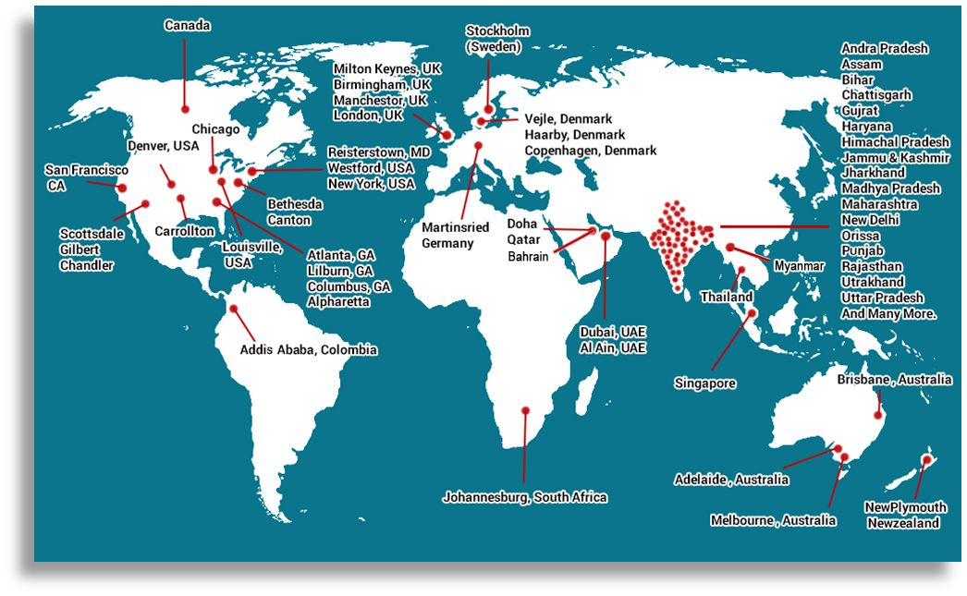
Dataman Clients – Geographically

Slide 6
Concepts
At Dataman, We run our race with the Belief that the only way to get better is to keep going.
Dataman has a pool of highly experienced and qualified professionals providing assistance to various clients with wide spread across the nation.

Slide 7
Technology
Technology Front End -
Internet Based- Using Java GWT framework Technology.
Facility of Java GWT framework for the Mobile phone operations in Android & I-Phones (IOS)
Facility of Clients server for Lan Nodes / Van Nodes for Finance, Tax-GST, & other Modules.
Technology Back End –
SQL Server 2017 ver. & above as per requirement
Reporting Tool -
Jasper Report

Slide 8
Software Features
Multi User Operation
Multi Company , Multi Location Operation
WEB Based Technology with SQL Server Back End.
Jasper Reports Designer enable user to design rapid and user customize reports.
Integrated Accounts, GST, Gate, Purchase ,Sales, Production, Deckle Management, Inventory Control, Web dealer Interface, Messaging Backup, Data Import / Export etc.
Add on Modules of Payroll, Export-Import, Barcode Interface, Machine Maintenance, Job work Module etc.

Slide 9

Some Glimpses of “Paper Biz WEB” ERP

Slide 10

Login Financial Year

Slide 11
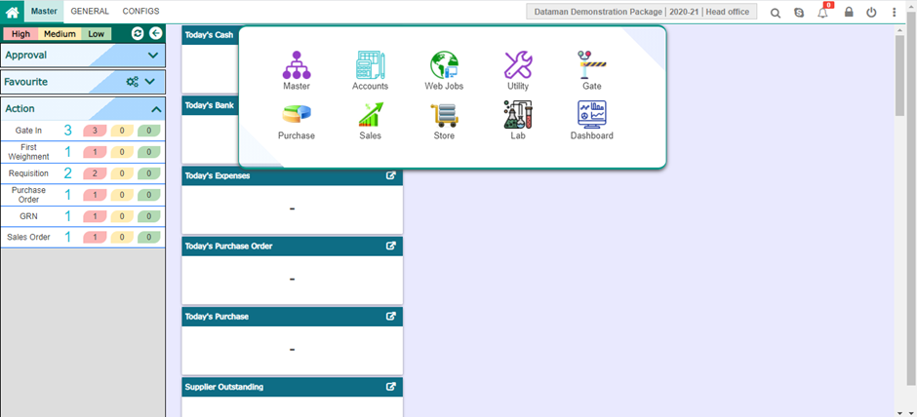
Modules in ERP

Slide 12


Gate Management
Gate Entry
Visitor Gate Pass
Unloading Entry
Second Weightment
First Weightment

Slide 13
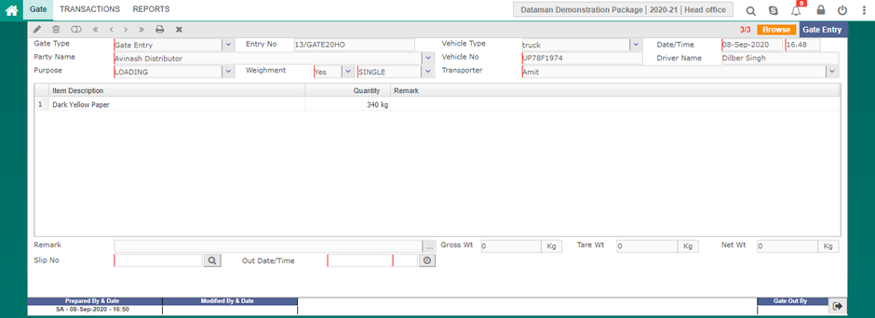
Gate Entry

Slide 14
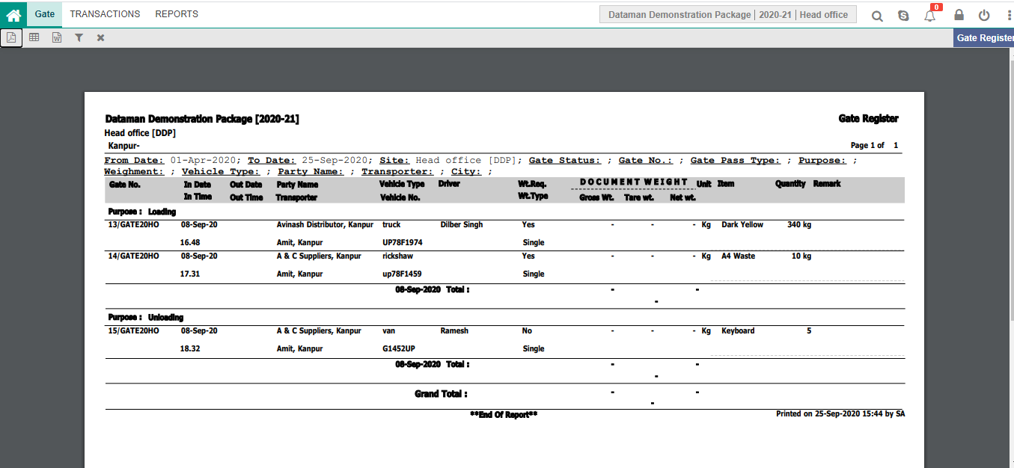
Gate Pass Register

Slide 15
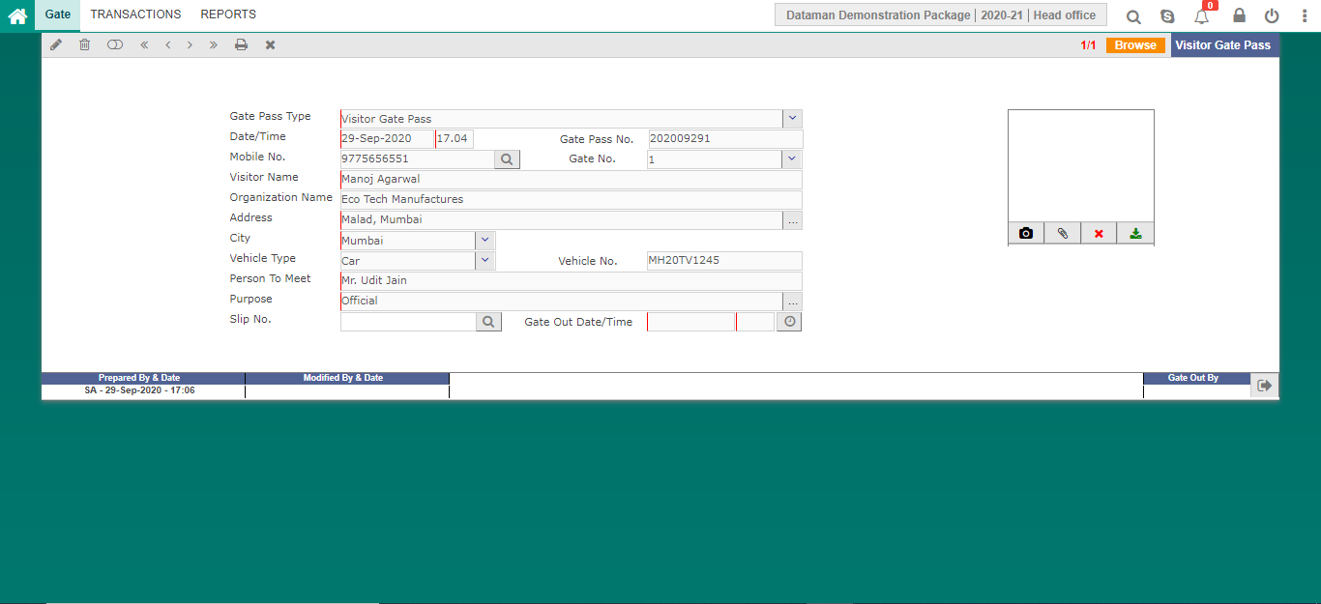
Visitor Gate Pass

Slide 16
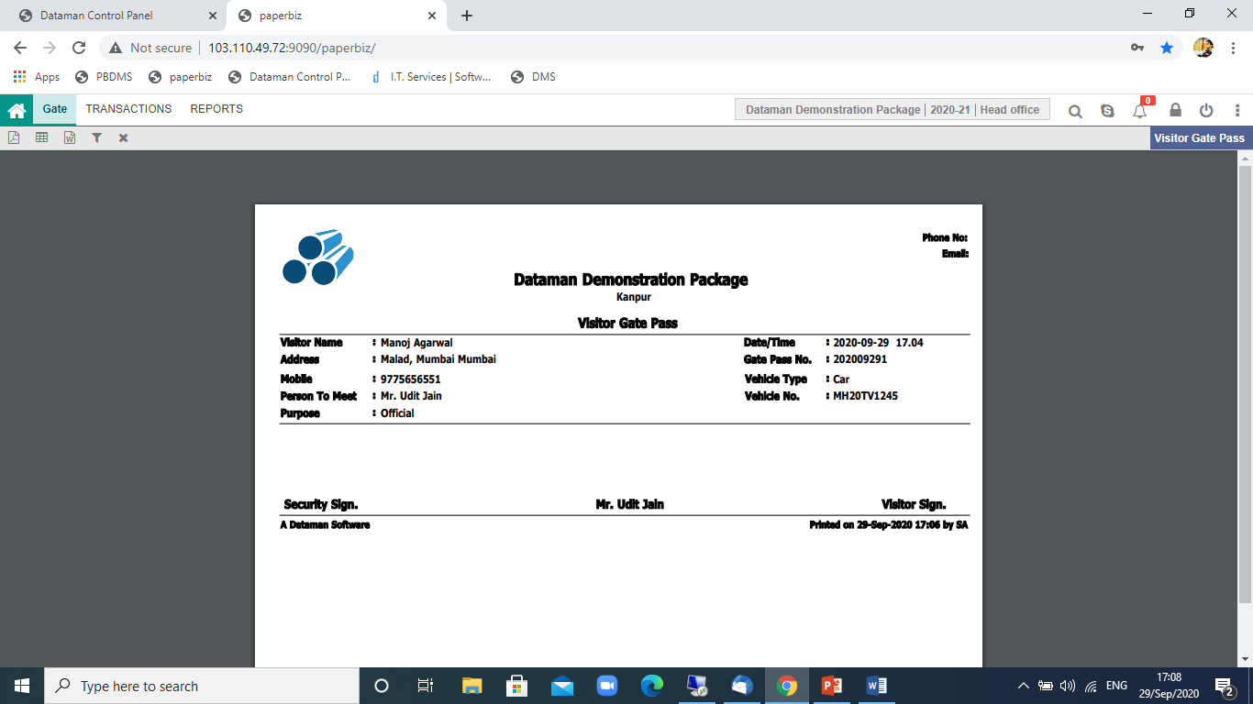
Visitor Gate Pass

Slide 17
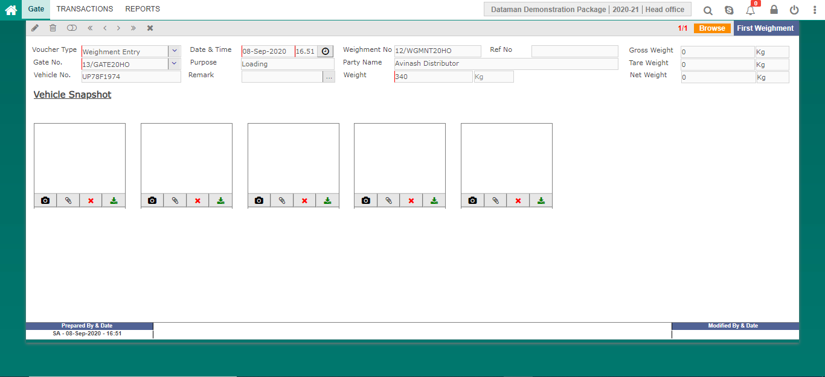
First Weightment Entry

Slide 18
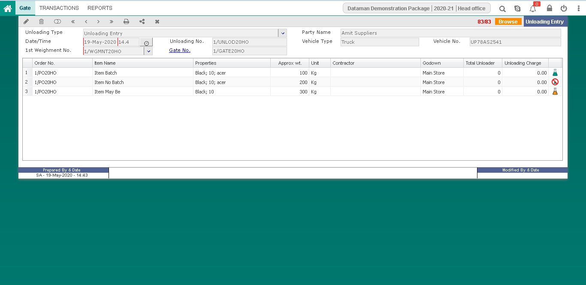
Unloading Entry

Slide 19
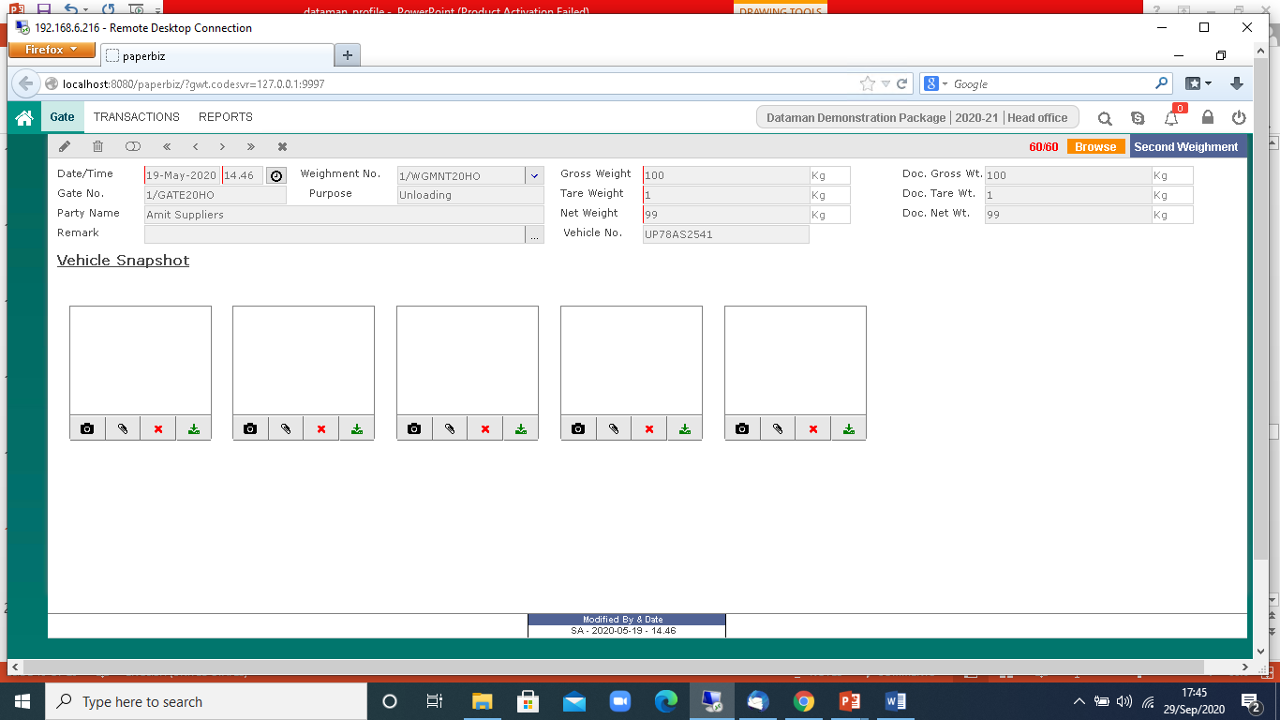
Second Weightment

Slide 20
Purchase & Procurement
Indent
Indent Assign
Quotation Entry
Purchase Order Entry
GRN Entry
Purchase Bill
Purchase Bill Direct
Purchase Return
Enquiry

Slide 21
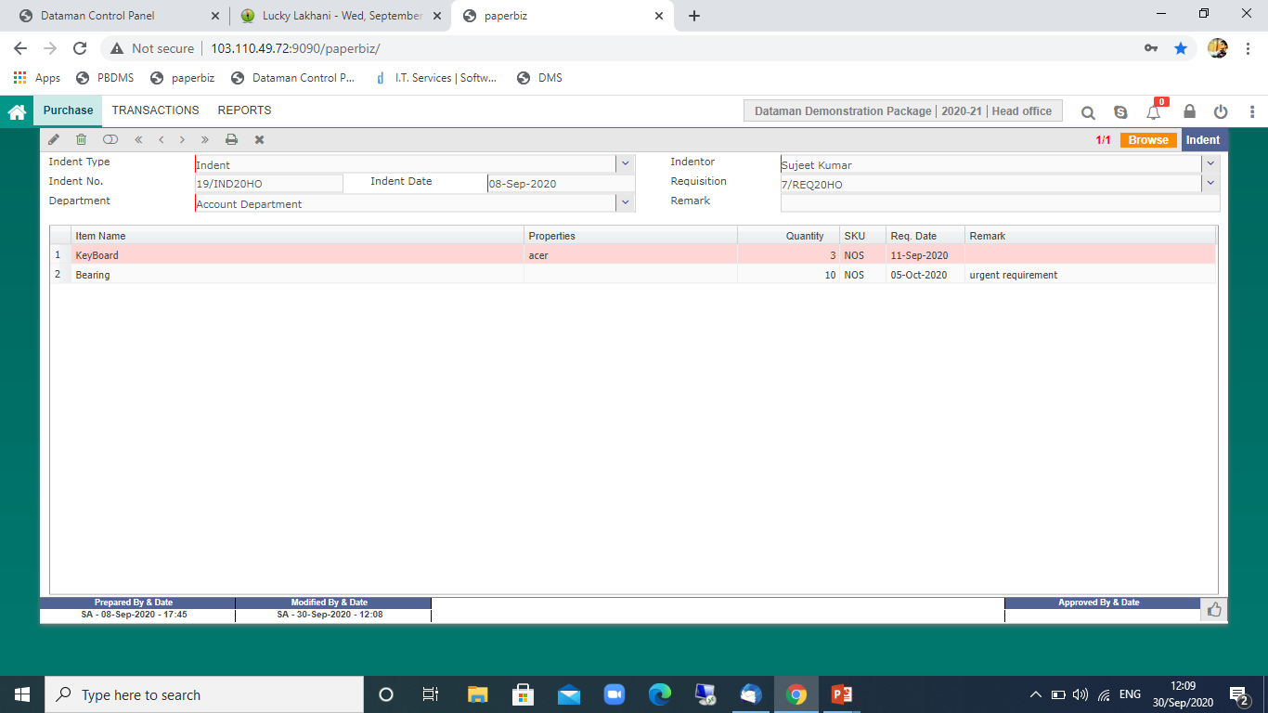
Indent Entry

Slide 22
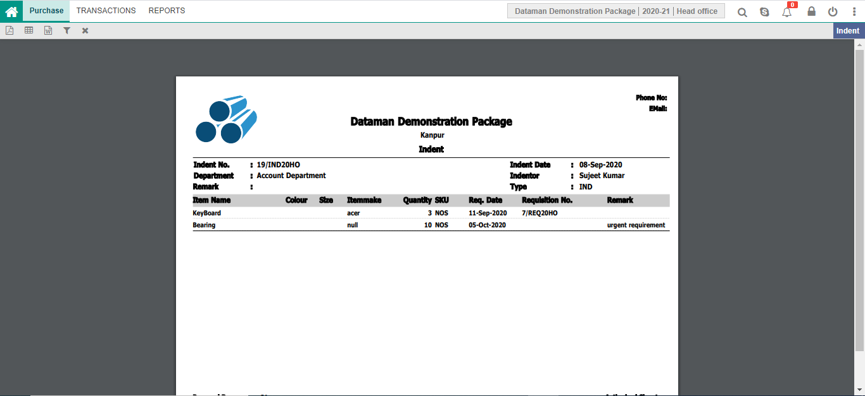
Indent Entry

Slide 23
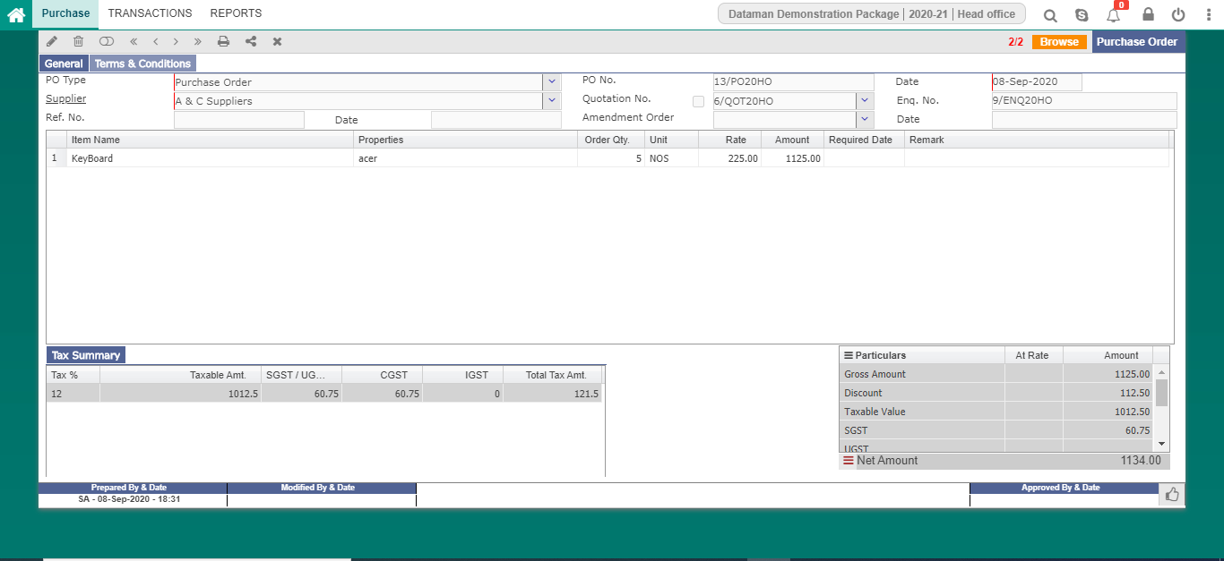
Purchase Order Entry

Slide 24
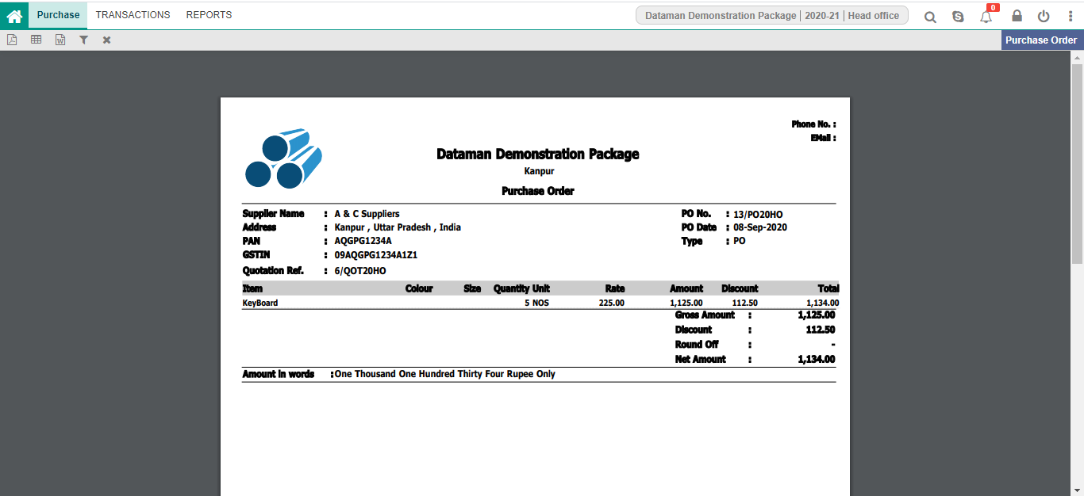
Purchase Order Entry

Slide 25
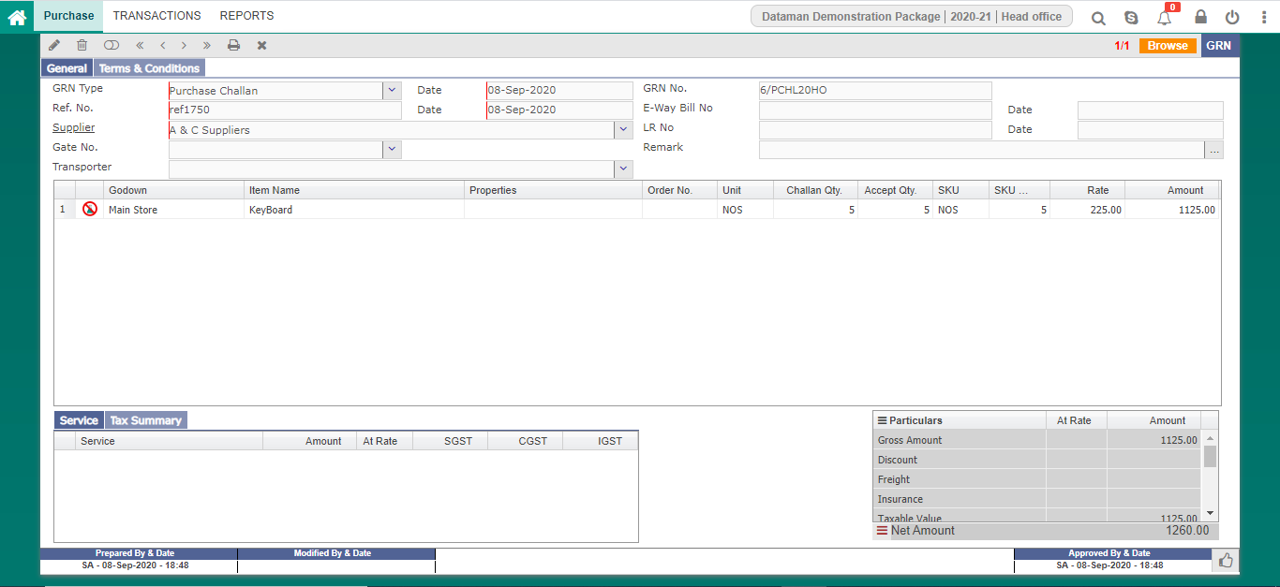
GRN Entry

Slide 26
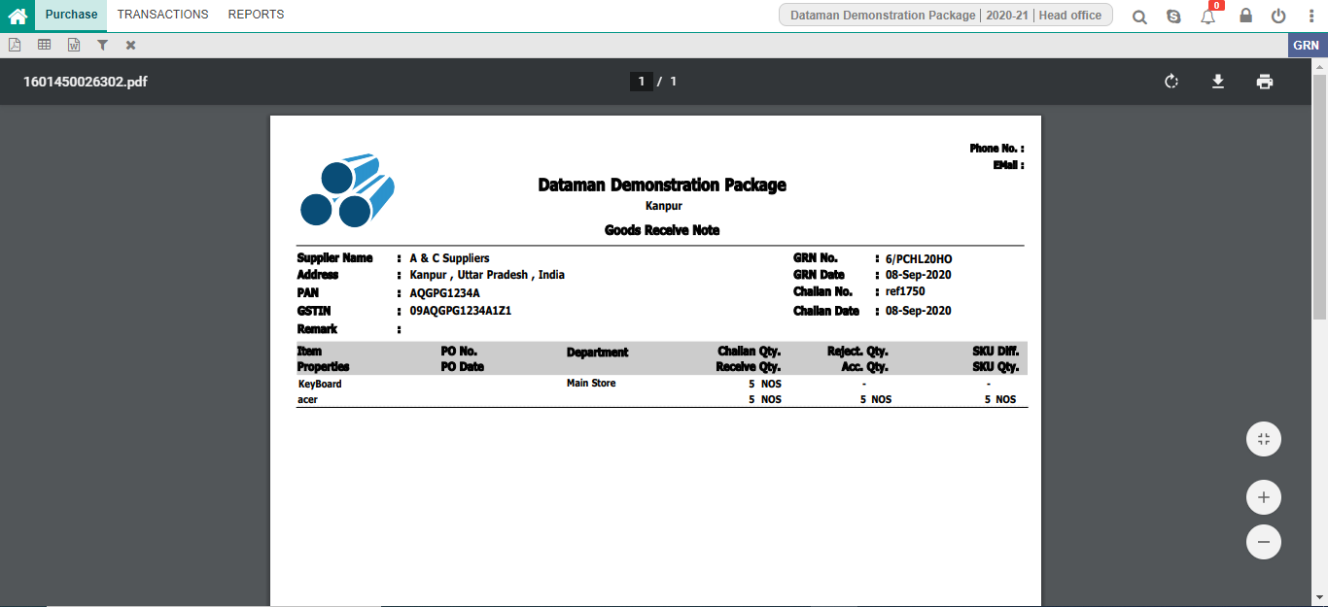
GRN Entry

Slide 27
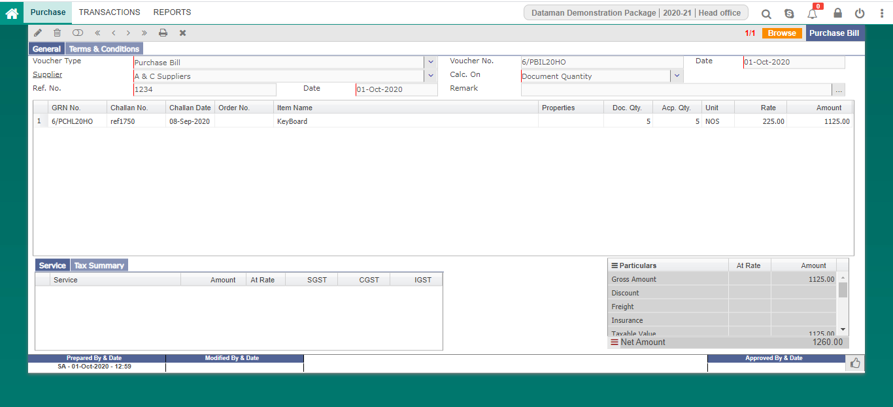
Purchase Bill Entry

Slide 28
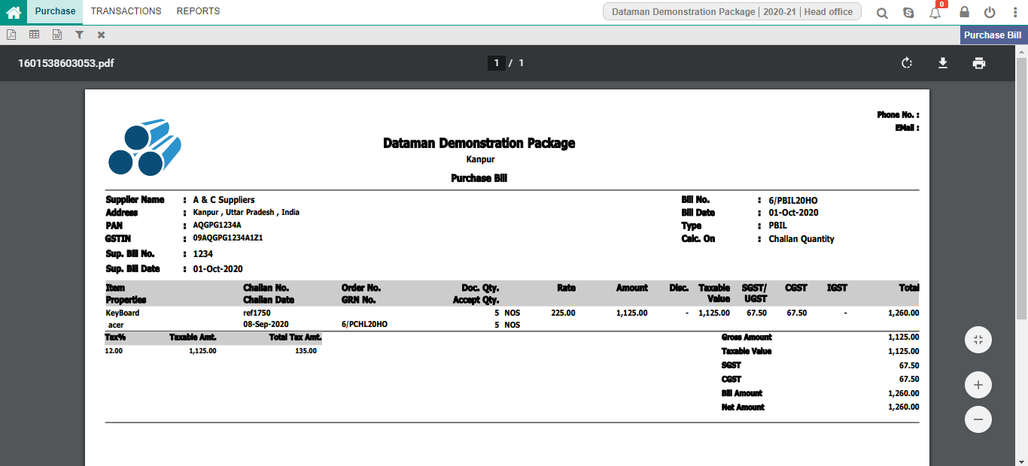
Purchase Bill Entry

Slide 29
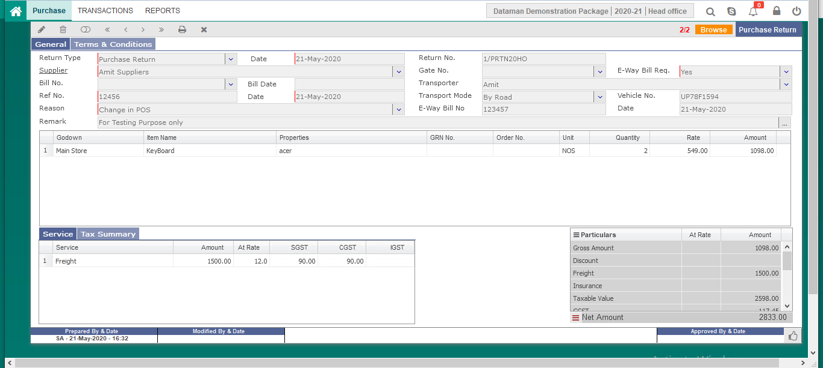
Purchase Return Entry

Slide 30
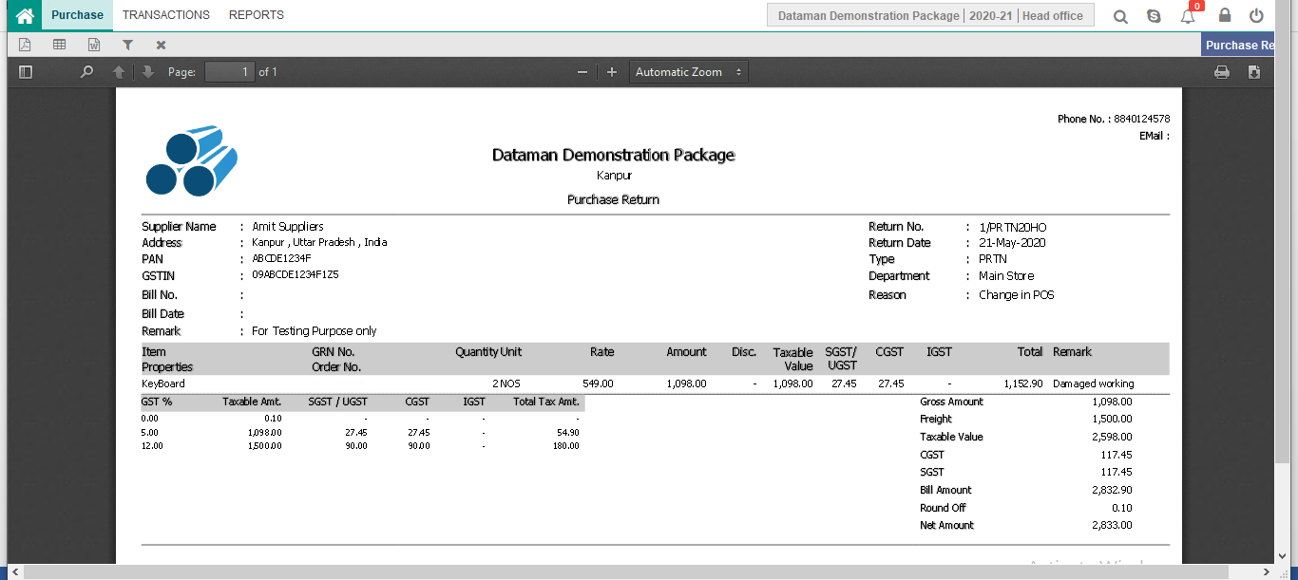
Purchase Return Entry

Slide 31
Sales & Dispatches
Sales Order
Work Order
Order Transfer
Finished Item Transfer
Finish Item Consumption
Loading
Sales Invoice
Reel Bundle Search
Daily Production

Slide 32
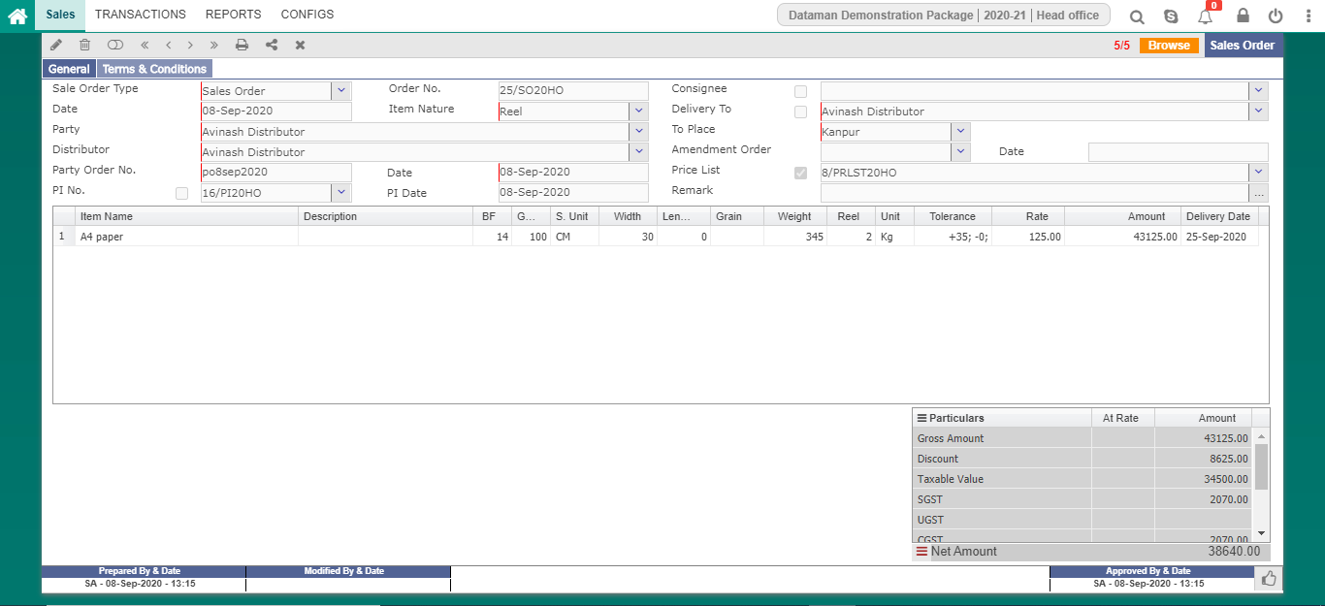
Sales Order

Slide 33
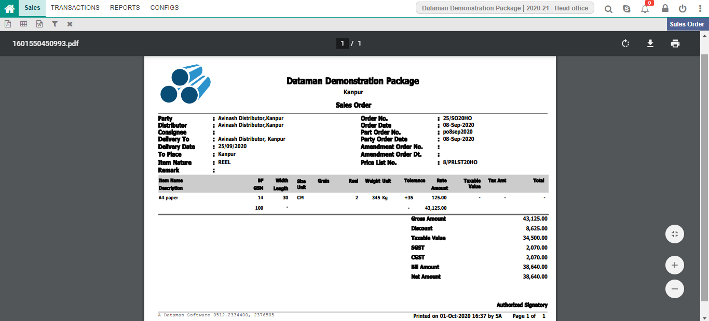
Sales Order

Slide 34
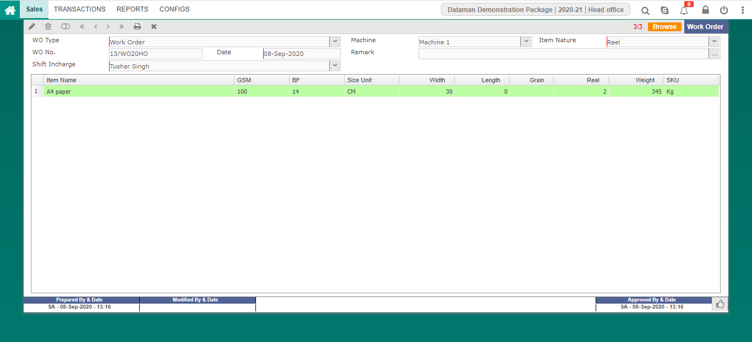
Work Order

Slide 35
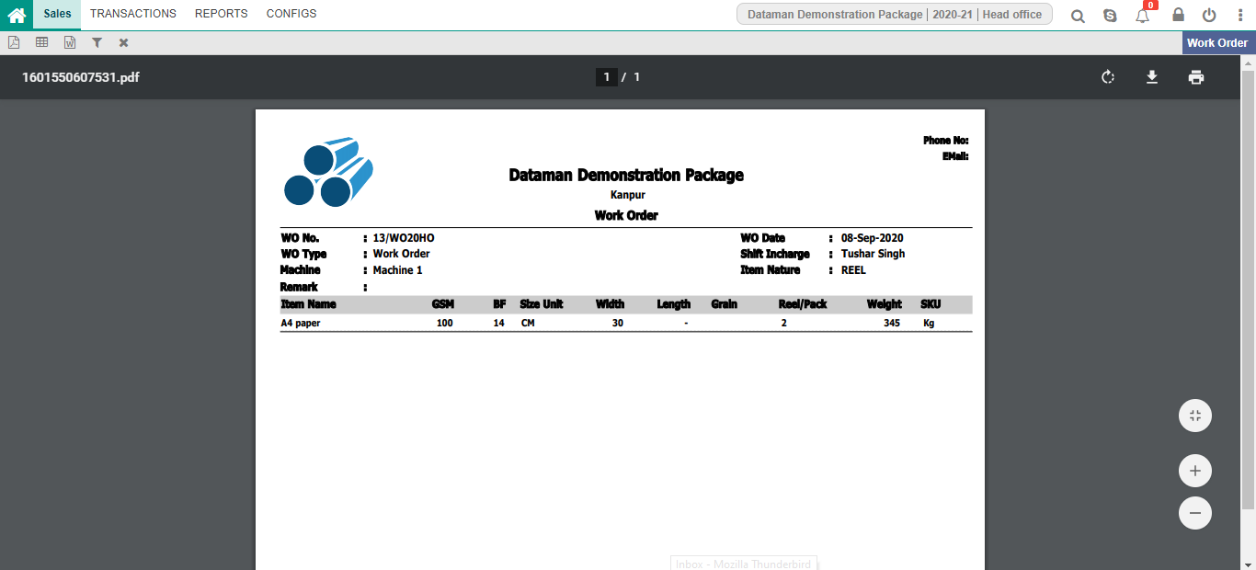
Work Order

Slide 36
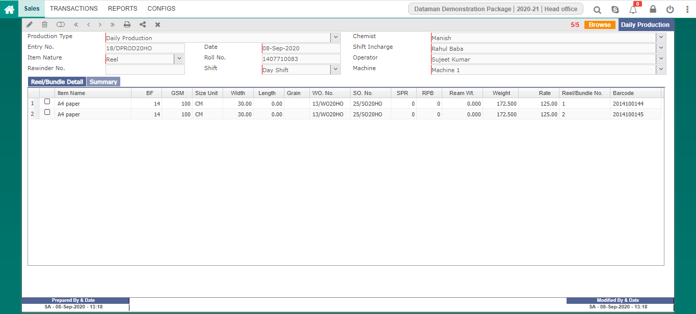
Daily Production

Slide 37

Daily Production

Slide 38
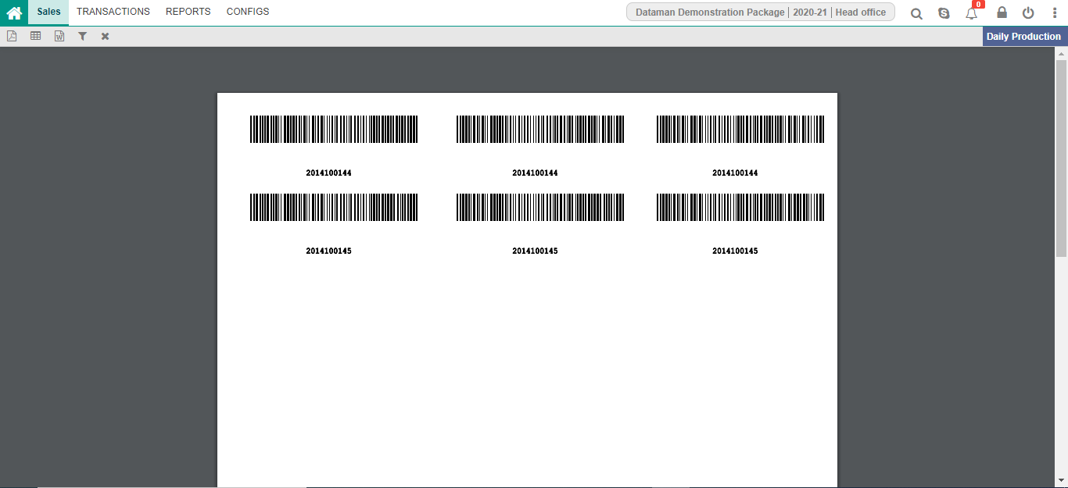
Barcode For Finish Reels

Slide 39
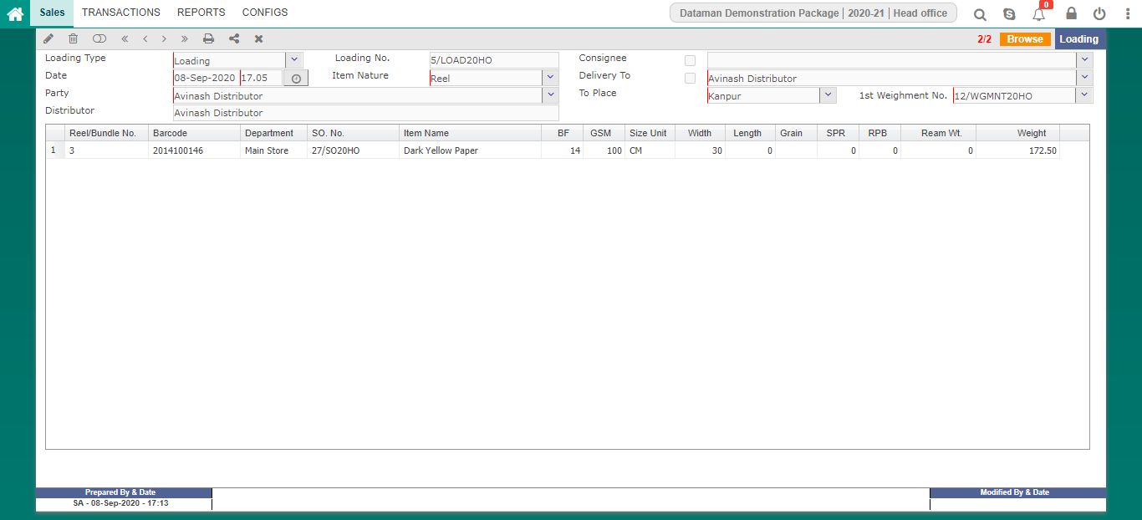
Loading

Slide 40
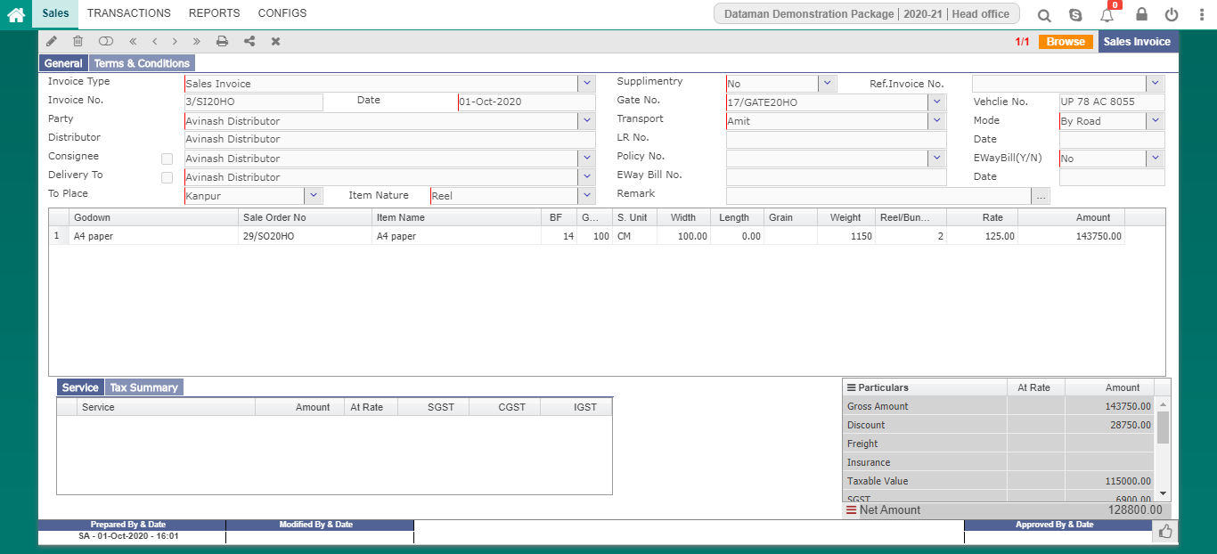
Sales Invoice

Slide 41
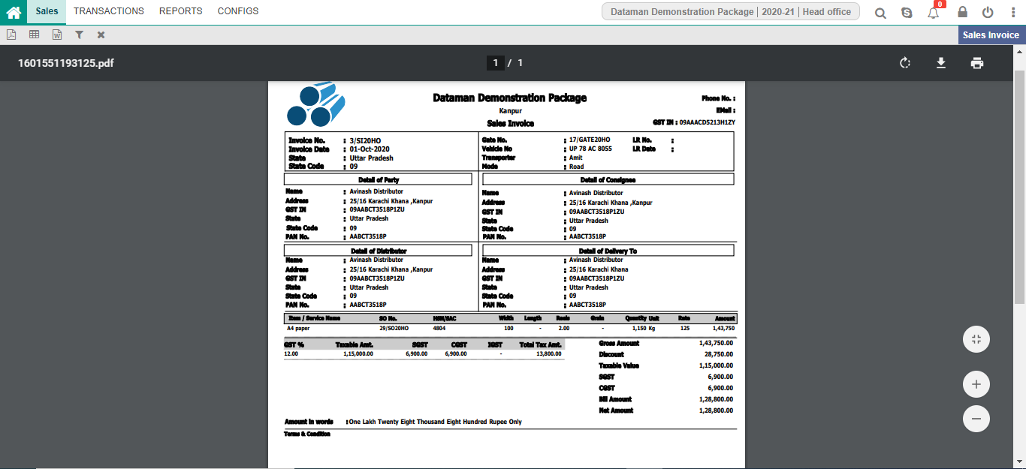
Sales Invoice

Slide 42
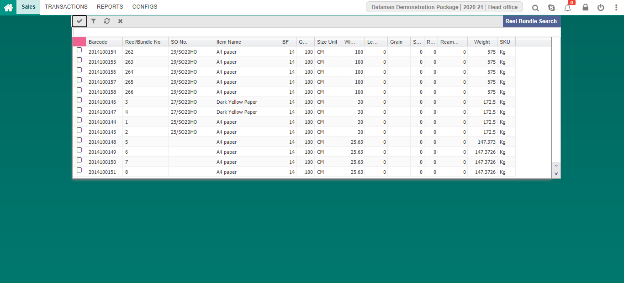
Reel Bundle Search

Slide 43
Stores & Inventory
Requisition
Item Opening
Item Issue/Receive
Item Consumption
Item Transfer

Slide 44
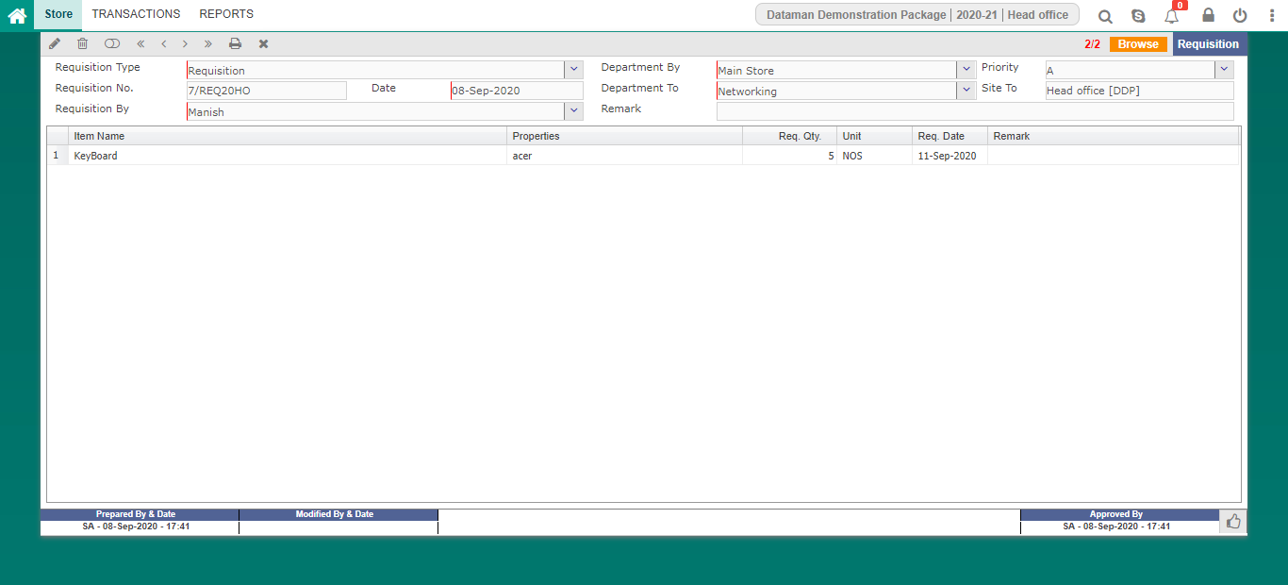
Requisition

Slide 45
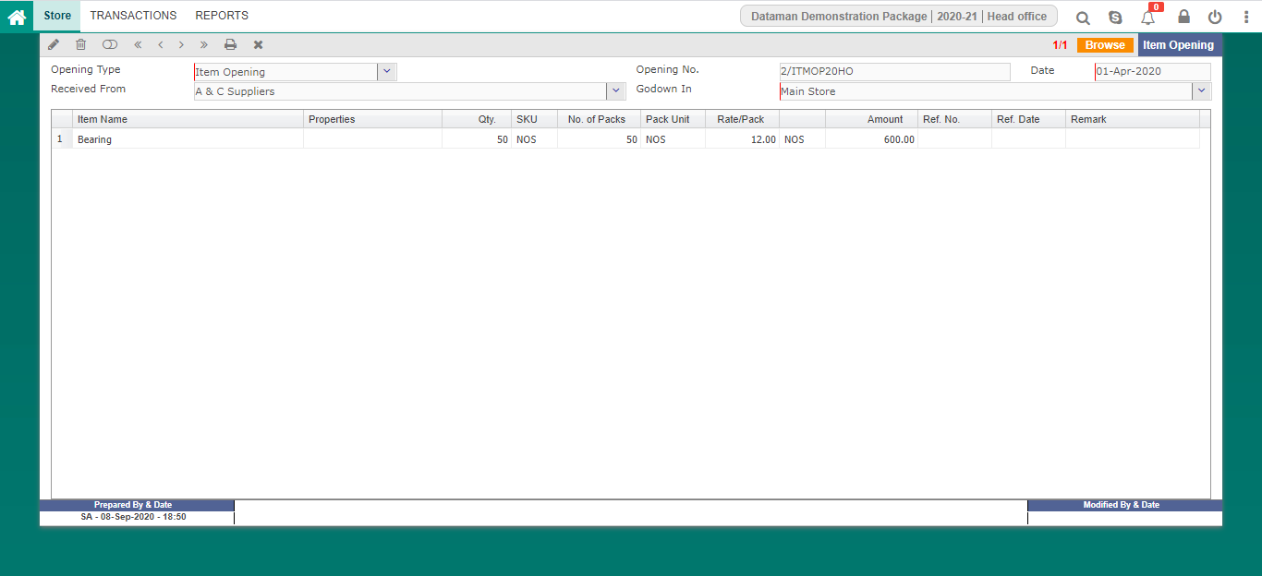
Item Opening

Slide 46
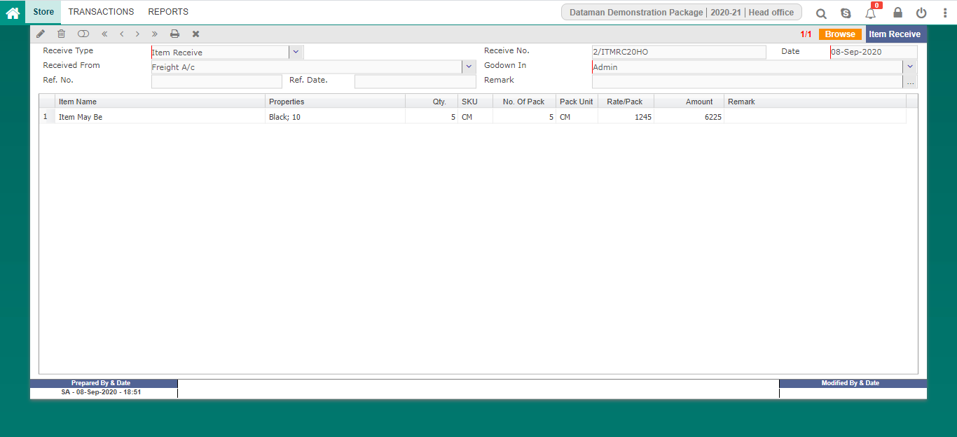
Item Receive

Slide 47
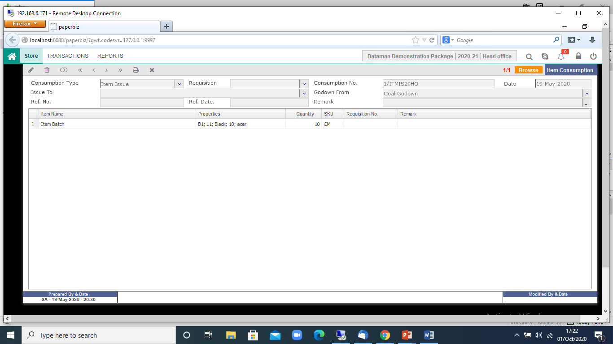
Item Consumption

Slide 48

Item Transfer

Slide 49
Financial Accounting
Account Opening
Payment Voucher
Receipt Voucher
Journal Voucher
Contra Voucher
GST Voucher
Bank Reconciliation
Fund Transfer
Cheque Printing
Voucher Adjustment Entry

Slide 50
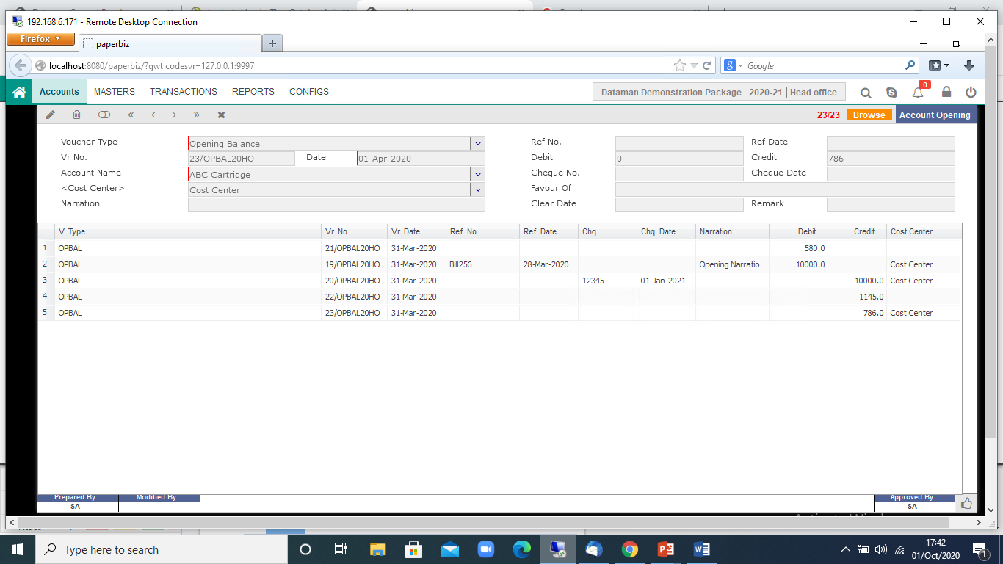
Account Opening

Slide 51
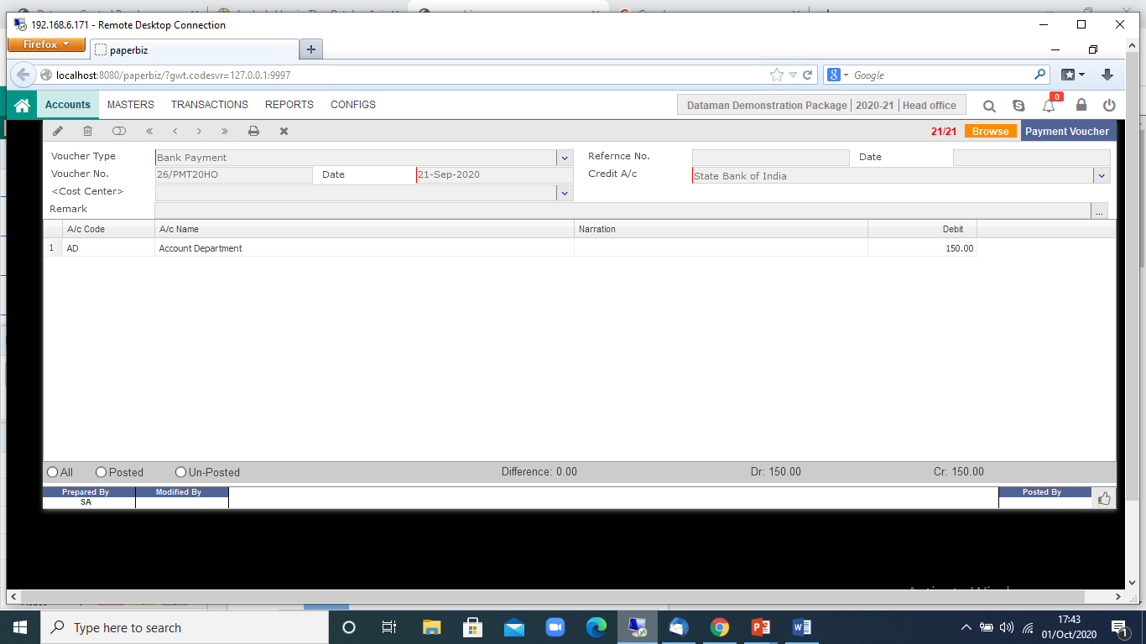
Payment Voucher

Slide 52
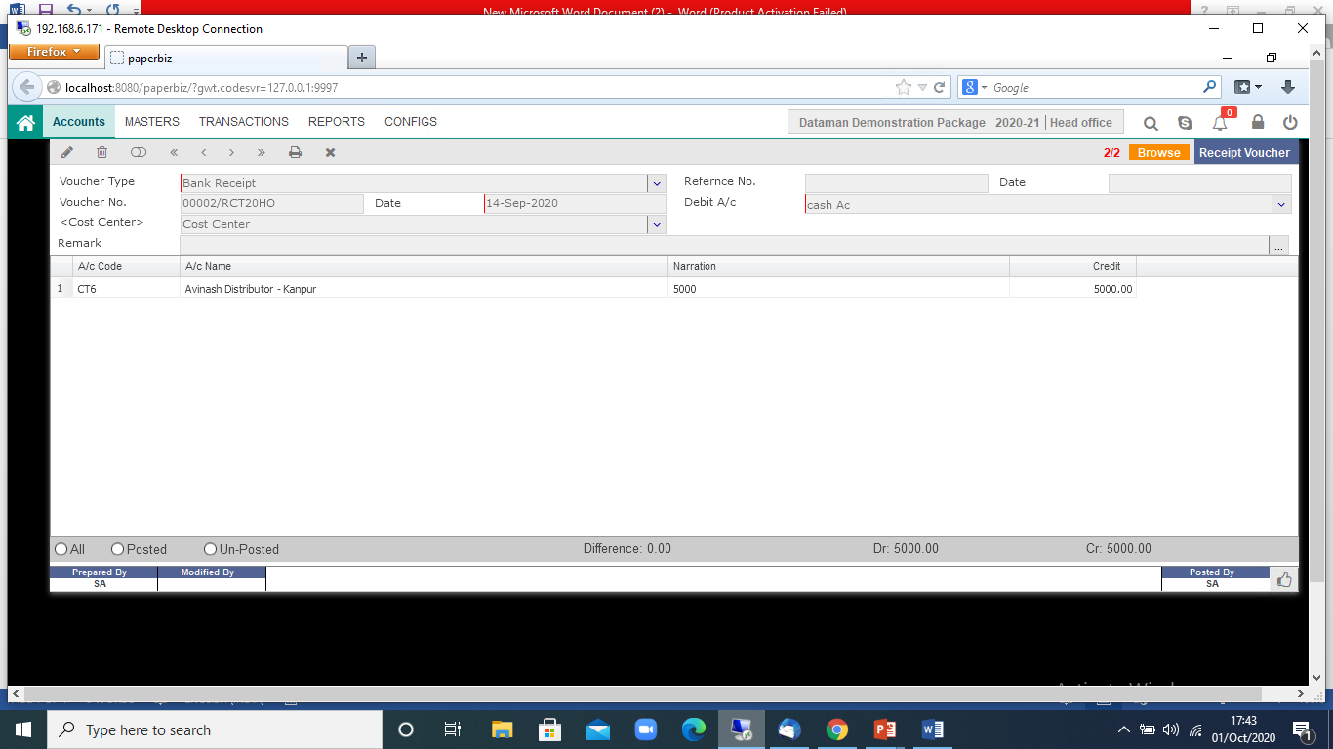
Receipt Voucher

Slide 53

Journal Voucher

Slide 54

Contra Voucher

Slide 55
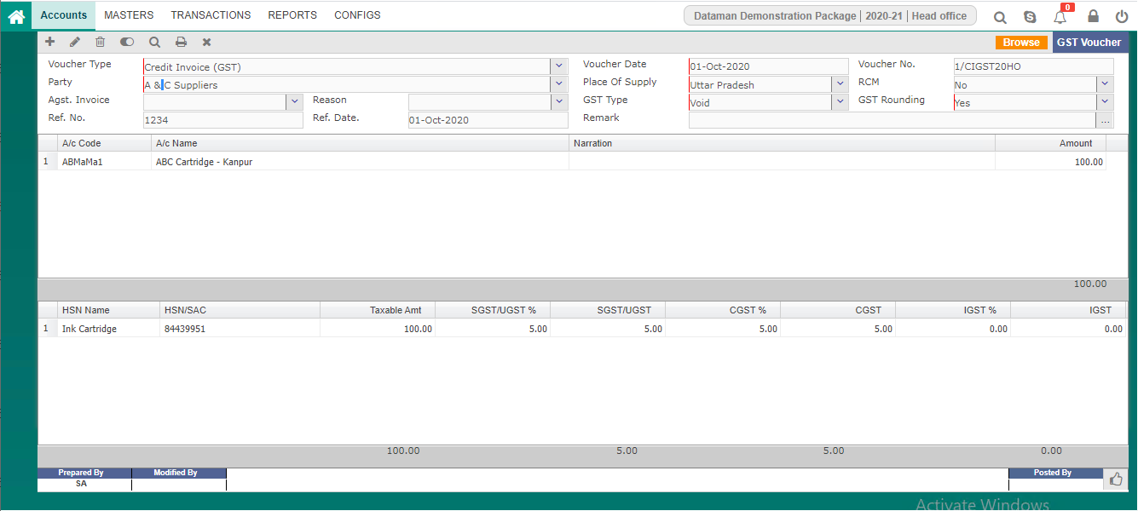
GST Voucher

Slide 56
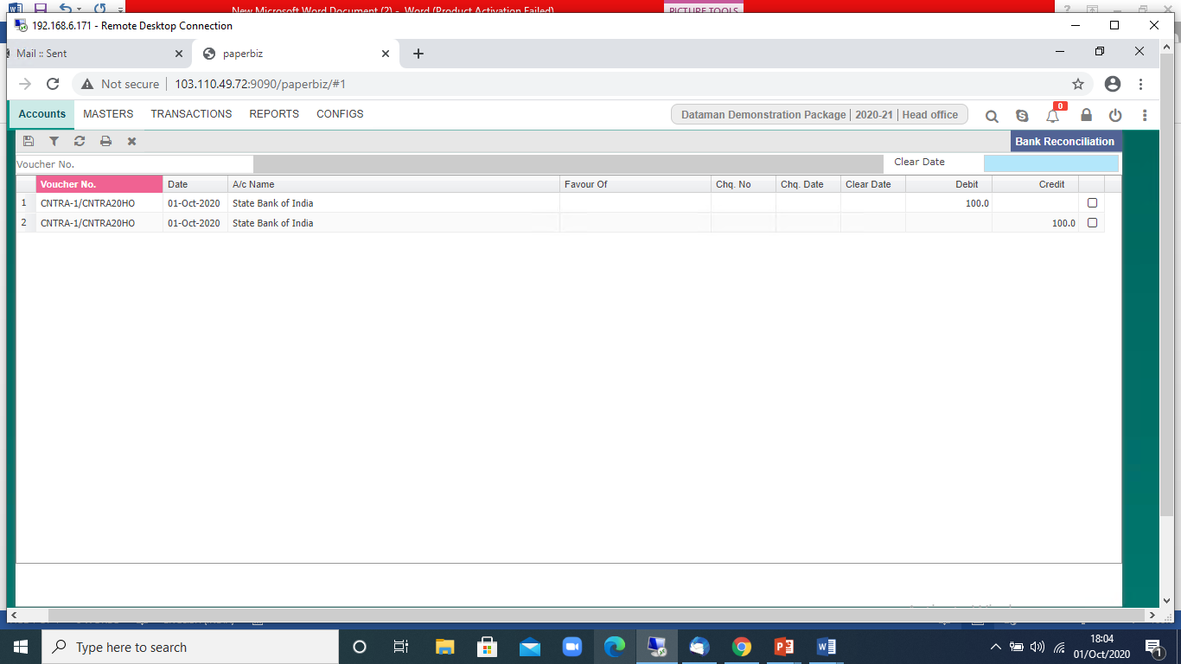
Bank Reconciliation

Slide 57
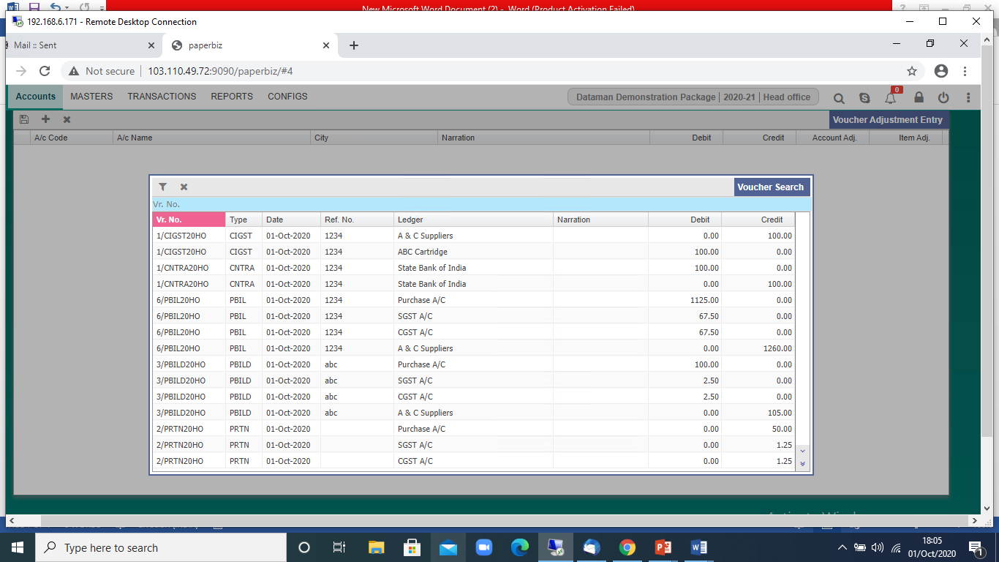
Voucher Adjustment Entry

Slide 58
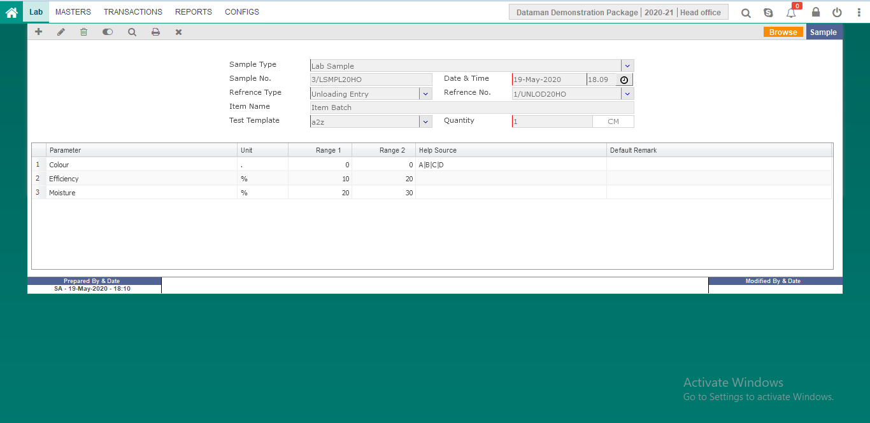
Quality & Lab Test Sample Entry

Slide 59
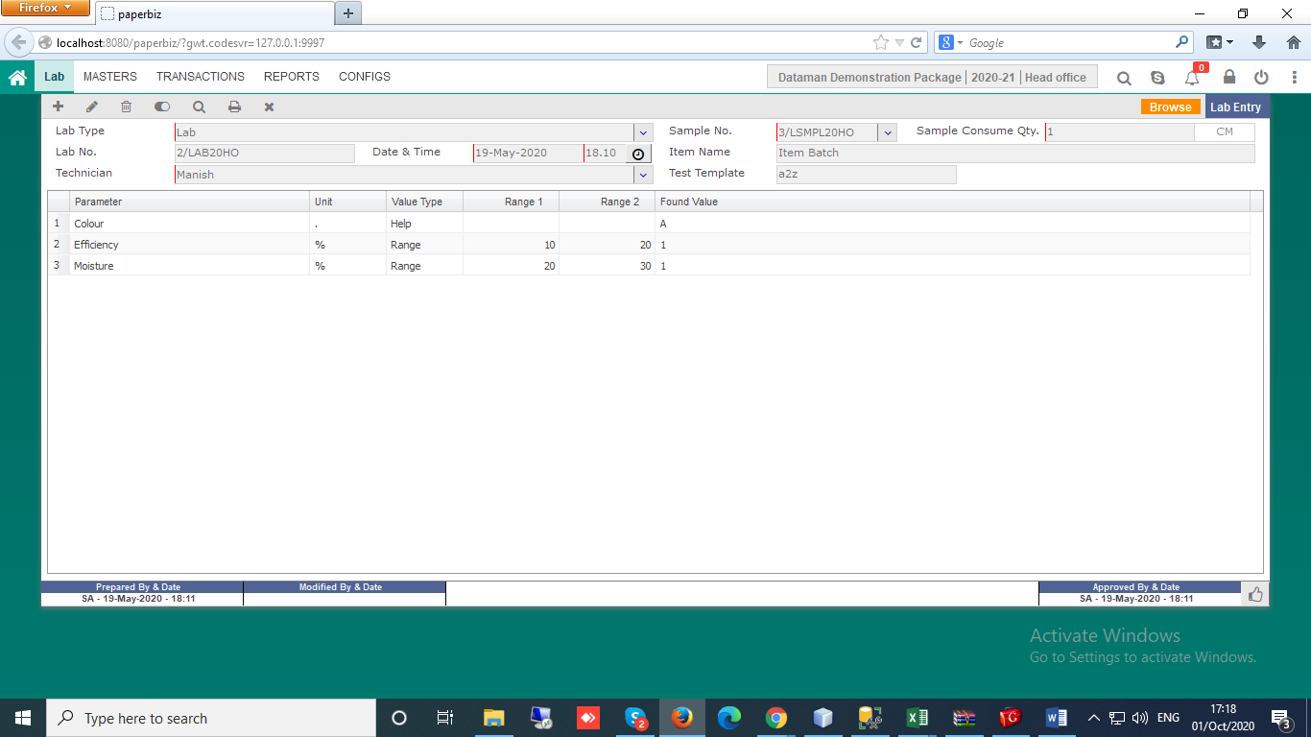
Lab Test Entry

Slide 60
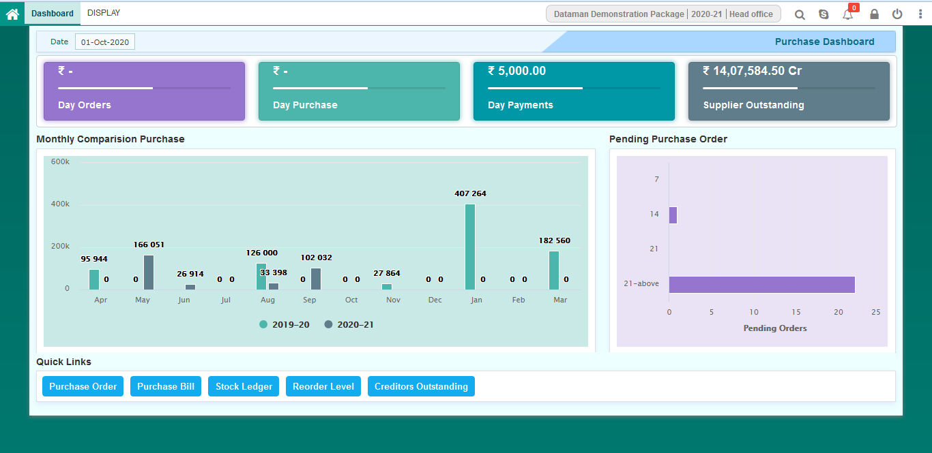
Purchase Dashboard

Slide 61
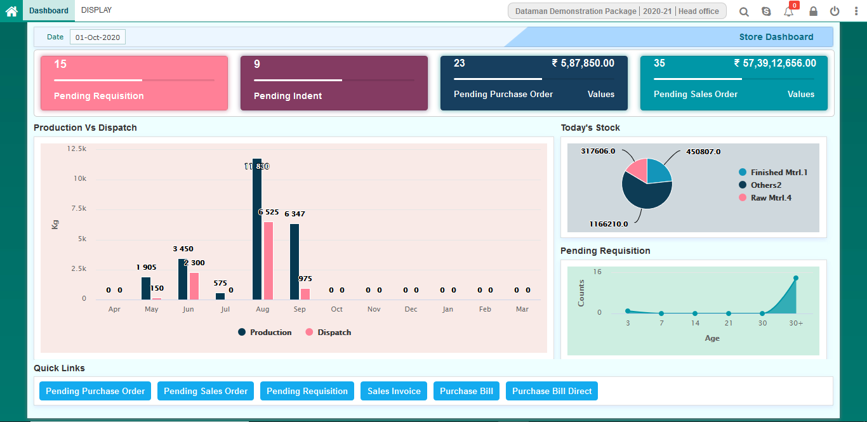
Stores Dashboard

Slide 62
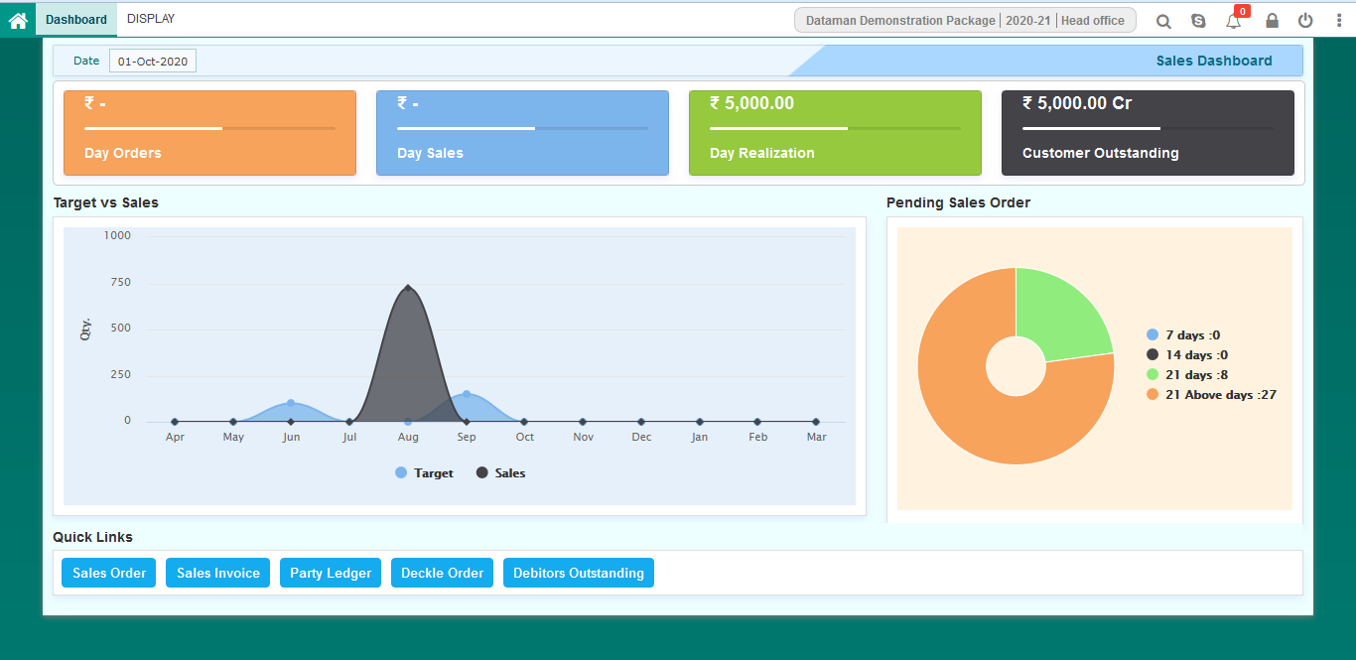
Sales Dashboard

Slide 63
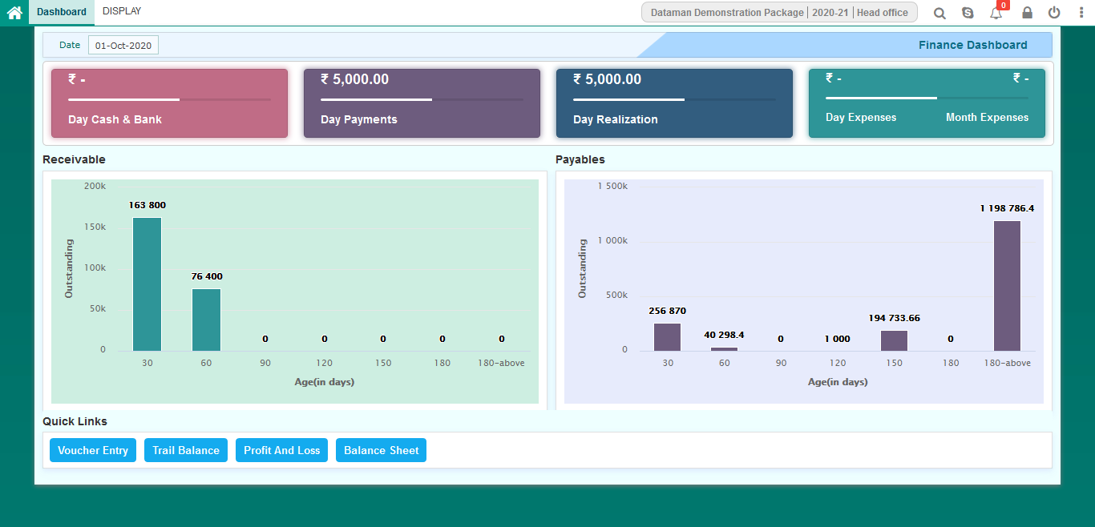
Finance Dashboard

Slide 64
Benefits
Better Funds Control
Effective Cost Management
Increase Productivity
Enhance Business Agility
Save Time
Reduces Costs

Slide 65


